Slide 1
Participatory modelling Introduction to participatory system dynamics and group model building
Slides developed by Nici Zimmermann

Slide 2
Population development in New York City

Slide 3
Population development in Boston

Slide 4
Population development in London

Slide 5
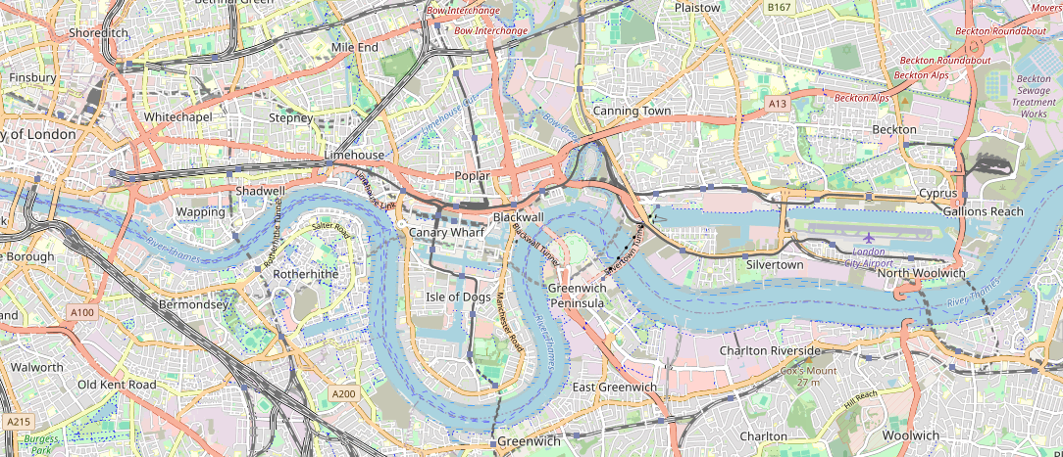
Docklands redevelopment area
Map data from OpenStreetMap
openstreetmap.org/copyright

Slide 6
The facilitation team
The facilitator, modeller and process coach may be executed by the same person simultaneously.
Not every role is always filled.
facilitator
modeller/reflector
process coach
recorder
gatekeeper
The subsequent pages describe the five different facilitation roles. The material is taken from Richardson and Andersen, 1995.
Richardson, G.P., Andersen, D.F., 1995. Teamwork in group model building. System Dynamics Review 11, 113–137.

Slide 7
Facilitator
Functioning as group facilitator and knowledge elicitor, pays constant attention to group process, the roles of individuals in the group, and drawing out knowledge and insights from the group.
This role is the most visible of the five roles, as the facilitator constantly works with the group.
Richardson, G.P., Andersen, D.F., 1995. Teamwork in group model building. System Dynamics Review 11, 113–137.

Slide 8
Modeller/Reflector
This person focuses on the model that is being explicitly (and sometimes implicitly) formulated by the facilitator and the group.
The modeller/reflector serves both the facilitator and the group. The person sketches the developing model structure, reflects information back to the group, restructures formulations, and exposes unstated assumptions that need to be explicit.
It is not uncommon that the facilitator and modeller role are played by the same person.
Richardson, G.P., Andersen, D.F., 1995. Teamwork in group model building. System Dynamics Review 11, 113–137.

Slide 9
Process coach
This person focuses on the dynamics of individuals and subgroups within the group.
Such a person can observe confusion, excitement, unwanted effects of jargon, and else.
The process coach may come in to make people heard and support the participatory and equitable process.
Richardson, G.P., Andersen, D.F., 1995. Teamwork in group model building. System Dynamics Review 11, 113–137.

Slide 10
Recorder
Writing down or sketching the important parts of the group discussion is the task of this person.
Together with the notes of the modeller/reflector, the notes and drawings made by the recorder should allow a reconstruction of the thinking of the group.
Modelling experience helps execute this role well.
Richardson, G.P., Andersen, D.F., 1995. Teamwork in group model building. System Dynamics Review 11, 113–137.

Slide 11
Gatekeeper
This person sits between the client and modelling team. They often have responsibility for the project on the client side, may have initiated it, help frame the problem, identify appropriate participants, works with the modelling support team to structure the sessions, and participates as a member of the group.
The gatekeeper is an advocate in two directions, assuring a good information flow between the client and modelling team.
The locus of the gatekeeper in the client organisation influences the process and the results.
Richardson, G.P., Andersen, D.F., 1995. Teamwork in group model building. System Dynamics Review 11, 113–137.

Slide 12
Scripts
Scripts are the activities (i.e. processes or sub-sessions) of participatory modelling workshops.
The Scriptapedia website is like a recipe book, providing many ingredients (scripts) that make a successful product (workshop).
One of the related readings concerned scripts: Andersen & Richardson, 1997: Scripts for Group Model Building.
You find very detailed information on the Scriptapedia website.
https://en.wikibooks.org/wiki/Scriptapedia

Slide 13
Scripts
Scripts can be divergent or convergent.
divergent (ideas)
convergent (consensus)
Divergent scripts try to assemble a broad arrange of ideas from participants.
Convergent scripts try to move towards group consensus

Slide 14
A typical agenda of a group model building engagement
Welcome
Hopes and fears (divergent)
Variable elicitation (divergent)
Graphs over time (divergent)
Nominal group technique (divergent)
Dot voting (convergent)
Model building (CLD) (convergent)
Policy option elicitation (divergent)
System stories (convergent)
Close (convergent)
Debriefing (evaluative) – just among facilitators
You find very detailed information on the Scriptapedia website.
https://en.wikibooks.org/wiki/Scriptapedia

Slide 15
Hopes and fears
Participants are given several sheets of paper in each color. The facilitator explains that they will be writing their hopes and fears for the project and then sharing them with the group.
The facilitator states which color represents hopes and which represents fears.
In a round-robin fashion (nominal group technique), each participant then reads one fear and one hope. The facilitator takes each hope and fear that the participant has read and posts it an the wall. After each participant has had a chance to share once, the facilitator may open the floor to participants to offer hopes and fears or may go around the room until everyone has shared all of their hopes and fears.
The facilitator then tries to identify some of the themes of the hopes and fears.
Recorders write down the hopes and fears in the session notes.
This and the subsequent scripts are copied from the Scriptapedia website.
https://en.wikibooks.org/wiki/Scriptapedia
https://en.wikibooks.org/wiki/Scriptapedia/Hopes_and_Fears

Slide 16
Graphs over time: to engage in framing the problem, initiating mapping, eliciting variables and the reference modes
Based on group size, decide whether to break participants into subgroups. In smaller groups N<10, allow individuals to work and present independently. In larger groups N >10, divide participants into groups of roughly 10. Ask the subgroups to sit together.
The modeling team hands out sheets of white paper to each participant or group.
The facilitator gives an example of how to draw a graph over time, carefully labelling X-axis "Time" with start time, end time, and now indicated with a vertical dashed line. The Y-axis is labelled with a variable name. The facilitator then sketches the behaviour over time.
The facilitator then asks participants to draw one variable over time per piece of paper. The participants should be given the option of including hoped for behaviour, expected behaviour, and feared behaviour on the same graph.
https://en.wikibooks.org/wiki/Scriptapedia/Graphs_over_Time

Slide 17
Graphs over time: to engage in framing the problem, initiating mapping, eliciting variables and the reference modes
The facilitator and wall-builder walk around and help participants with the task if they need it. Allow 15 minutes or until the group runs out of steam to complete the task.
Reconvene as a large group.
If N<10, the facilitator takes one graph at a time from each participant, holds it up in front of entire group and asks him/her to talk about it. Ask for participants to share the "best stuff" first. Clarify timescale, variable names, etc.
If N>10, instruct subgroups to share their graphs with each other and choose the ones they think are most important. The facilitator then goes to each subgroup and holds the first graph they have selected up in front of entire group. The subgroup spokesperson talks about the graph. Ask subgroups to share the "best stuff' first. Clarify timescale, variable names, etc.
The facilitator then hands the graph to the wall builder.
https://en.wikibooks.org/wiki/Scriptapedia/Graphs_over_Time

Slide 18
Graphs over time: to engage in framing the problem, initiating mapping, eliciting variables and the reference modes
The facilitator repeats steps 6 and 7 with each participant or subgroup, taking one graph at a time until all graphs are shown or time has run out. Finish by asking if any participant has something else that really ought to be shown.
During steps 7-8, each graph is posted on the wall. The wall builder tries to cluster the graphs meaningfully on the fly based on themes and variables.
The facilitator asks the wall builder to explain the clusters of graphs on the wall. The wall builder tries to summarize dynamics that help to characterize the problem that emerges from the participants' graphs.
The facilitator enables the participants to talk about the clusters the characterization of the problem they imply.
Consider labeling the clusters based on themes or related There is potential for the modeler to dose by highlighting beginnings of feedback thinking in the dynamic problem.
https://en.wikibooks.org/wiki/Scriptapedia/Graphs_over_Time

Slide 19
Nominal group technique: to generate an initial set of ideas (e.g., variables or dynamics)
Ask the participants to write down ideas about things that involve the problem variable. These might be causes or consequences of the problem, or any elements a participant feels are important to the issue at hand. Ask the participants to do this as much as possible in terms of variables. Explain that a variable is something that may increase or decrease over time. lt does not already have a value an a particular scale - as in 'young employees'. In this case we would include average age of employees so that the value may increase or decrease over time. lt is also not a categorical or nominal variable – as in type of holiday chosen. Duration of holidays or costs of holidays are aspects which may be used in a model. If it is not possible to formulate an idea as a variable, it does not really matter; the facilitator and the rest of the group can work together to find a variable.
Give the participants a few minutes to write down their own ideas.
https://en.wikibooks.org/wiki/Scriptapedia/Nominal_Group_Technique

Slide 20
Nominal group technique: to generate an initial set of ideas (e.g., variables or dynamics)
Explain that you are going to gather ideas and show them on the board or computer screen for everyone to see. Ask each participant for one idea and write this on the white board or blackboard. Pay attention to the conversion into variables and check to see if the other group members know what the person contributing the idea means. Allow a clarification of meaning, but not a discussion on the relevance or importance of the idea. Explain that in this phase, the person contributing the idea has the last word: if he or she prefers a particular formulation even if other object, the proposed formulation will be put on the central board or screen. In the next phase, when starting to build the model, a relation will only be included when all participants agree. So while in NGT an individual participant 'hm the power', in the phase of drawing relations we strive for consensus.
Stop collecting ideas after two or three rounds. Emphasize that the aim of this phase is only to create an initial list of variables so that model building can begin, and that variables that were not written on the board for the group are not automatically discarded. During the model building process, variables from the individual lists or even entirely new variables can be added.
https://en.wikibooks.org/wiki/Scriptapedia/Nominal_Group_Technique

Slide 21
Dots: to sift through many possible choices and select those most important to the participant group
The facilitator gives every participant the same number of dots.
The facilitator instructs participants to place their dots beside the items they think are most important to them. They can distribute the dots any way they want (e.g. put all of them on behaviour over time graph or spread dots out across several graphs).
The facilitator tallies the dots beside each item to create a ranked list of importance.
https://en.wikibooks.org/wiki/Scriptapedia/Dots

Slide 22
Initiating and Elaborating a Model: to initiate mapping, elicit relations and feedback loops
Remind the group of the problem variable, preferably sketched as a reference mode of behaviour. Remind the group of the list of variables elicited before. Place the list of variables in such a way that it is visible to the group of participants. Write the problem variable in the centre of a white board or blackboard.
Build the model by following steps a, b and c in the figure below (cf. Vennix, 1996: 120).
Ask participants which variable from the collected list is a cause for changes in the problem variable. When someone makes a suggestion, include this in the drawing of the model in order to visualize what is meant. Then check to see if everyone agrees with the proposed relation. If someone disagrees, ask for clarification and try to determine what the group thinks the relationship should be. If a discussion goes on too long, you can choose to temporarily 'park' this item and continue with another part of the model. Hopefully, there will not only be variables that have a direct relationship with the problem variable, but you will also build a few logical chains of reasoning (via intermediate variables) into the model. In addition check the polarity (positive or negative) of the relationship.
https://en.wikibooks.org/wiki/Scriptapedia/Initiating_and_Elaborating_a_Causal_Loop_Diagram

Slide 23
Initiating and Elaborating a Model: to initiate mapping, elicit relations and feedback loops
After spending some time doing this, proceed to the consequences of changes in the problem variable.
At the point where a feedback chain becomes closed, check with the entire group to see if the chain as whole is correct. Check again to see if a loop is positive or negative. The Ratio Exercise script may be used to draw out loops.
In the last part of the session, analyze the model by checking the feedback loops one more time. Before you do the group session, make sure you do the following. If there is a list of parked issues, go through them. State once more what has been done and what will happen with the final products. Formulate a few concise conclusions. As Andersen and Richardson (1997) say: 'end with a bang!' Make sure that all the information which is necessary for the report has been noted.
https://en.wikibooks.org/wiki/Scriptapedia/Initiating_and_Elaborating_a_Causal_Loop_Diagram

Slide 24
Initial policy options: to help the team frame the problem, implicitly elicit variables and to suggest solutions
The facilitator sets up task by asking participants to write short phrases naming policies that participants would like to see discussed, modeled, and simulated in the course of the work. There should be one policy per page. They could be policies tried in the past or currently, or policies being talked about for the future including both ideas that are considered realistic or "wild" ideas that exceed expectations for what is feasible.
The participants may work in pairs to build confidence and share thinking while still keeping the divergent nature of the group task.
The facilitator collects policy pages one at a time (receiving one page per pair and going on to the next pair to assure complete involvement). Ask each pair to talk about their proposed policy option.
The wall builder posts the policy pages on the wall, clustering them on the fly according to emerging themes.
Repeat steps 5 & 6 until done, or time runs out.
The facilitator asks the wall builder to describe the theme groups (clusters), justify the choice of clusters, and talk about what he or she sees in the clustering.
https://en.wikibooks.org/wiki/Scriptapedia/Initial_Policy_Options

Slide 25
System stories: to connect policy suggestions with system structure
The facilitator can ask the group to generate policy stories based on their prior understandings of the system and the ideas they have gleaned from the workshop. Often these policy stories can be explicitly linked to the diagrams discussed above. Again, this sort of task is well suited to a nominal group technique, with subgroups of two or three addressing the same policy and then sharing their thoughts.
A more focused variant of the policy stories script asks participants in subgroups to sketch graphs over time of key indicator variables for a given policy. Sharing these visions is facilitated by having participants sketch graphs on overhead transparencies.
Hovmand, P.S., Rouwette, E.A.J.A., Andersen, D.F., Richardson, G.P., Kraus, A., 2013. Scriptapedia 4.0.6, accessed 1. March 2015, http://tools.systemdynamics.org/scrpda/scriptapedia_4.0.6.pdf.

Slide 26
Debriefing: to reflect impressions of the GMB session and provide support to team members for improving GMB practice
The debriefer assembles the modeling team and announces the start of the debriefing session.
The debriefer reviews the process the team will use to conduct the review.
The activity begins with a check-in to see how people are doing. This is important regardless of whether the session went well or badly.
Ask the following questions:
How are you feeling about how this GMB session went?
Overall, did we accomplish what the session was designed to do?
What went well during this session?
Were there any rough parts for you?
What did you learn from this session?
How could the session have been improved?
https://en.wikibooks.org/wiki/Scriptapedia/Debriefing

Slide 27
The workshop

Slide 28
Agenda
Variable elicitation
Graphs over time
Nominal group technique
Dots
Initiating and elaborating a model
https://en.wikibooks.org/wiki/Scriptapedia

Slide 29
Variable name:
Units:
When:
today
When:

Slide 30
Variable name:
Units:
Feared
Most likely
Desired
When:
today
When:

Slide 31
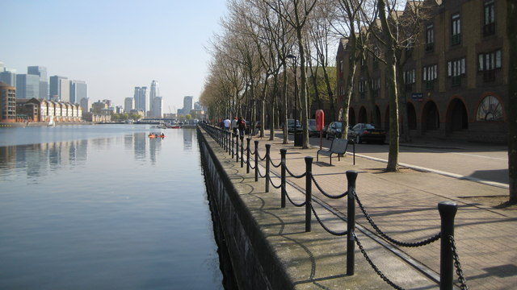
The docklands after redevelopment
Rotherhithe: Greenland Quay, Greenland Dock, SE16 by Nigel Cox: https://upload.wikimedia.org/wikipedia/commons/3/39/Rotherhithe%2C_Greenland_Quay%2C_Greenland_Dock%2C_SE16_-_geograph.org.uk_-_1828093.jpg

Slide 32
Population development in London

Slide 33
Population development in Boston

Slide 34
Population development in New York City

Slide 35
Why would you do participatory modelling?
Provides a structured process: problem elicitation – system-wide analysis – recommendation
Deals with ambiguity and conflict and creates consensus
Provides the path for implementation and change
Allows for interdisciplinarity
Inclusion and social justice
Insights into unintended consequences distant in space and time
New questions
Considers multiple dimensions
Multiple goals and success criteria of different stakeholder groups
We want to know how to balance between the goals/criteria → MCDA

Slide 36
Why would you do participatory modelling?
Please share your thoughts!

