Slide 1
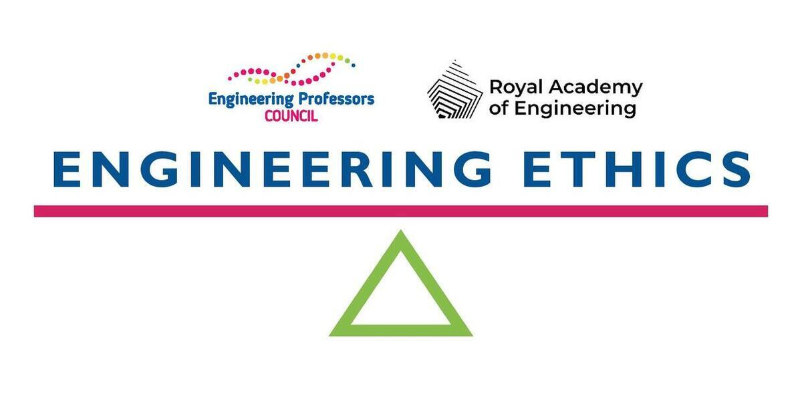
WHY?
At the heart of engineering is the desire to make the world a better place. Developing the ability to determine better from worse, and right from wrong is as central to an engineer as maths or design skills. And this is where ethics comes in.
Integrating ethics in engineering teaching supports national and international initiatives towards social and environmental responsibility.
Engineering ethics education complements institutional efforts towards interdisciplinarity, sustainability, EDI, and community engagement.
Learning how to embed ethics in engineering supports educators in their own professional development towards research-based teaching, active learning, and values-centred practice.

Slide 2
WHAT?
The Engineering Ethics Toolkit is a suite of resources, advice and case studies to help educators integrate ethics into the learning of every engineer.
The Toolkit contains ready-to-use classroom resources for engineering educators, suitable for those who are new to teaching ethics, as well as those who are more experienced.
The case studies and teaching materials highlight current and emerging real-world issues and contain a variety of suggestions for implementation rooted in educational best practice.
The interactive Ethics Explorer helps educators understand, plan for, and implement ethics learning across engineering curricula and showcases its alignment with AHEP criteria and graduate attributes.
Guidance articles provide concise descriptions of key topics in engineering ethics education, highlighting solutions and promoting engagement with further resources.

Slide 3
HOW?
The Engineering Ethics Toolkit is the product of experts sharing tried and tested approaches.
The Toolkit materials were created and developed by academic and industry professionals from a variety of fields across three continents.
The resources have already been successfully used in many different settings such as online and hybrid teaching, lecture sessions, and problem-based learning scenarios.
The Toolkit is a community-owned project, and anyone can suggest or submit a new resource or get involved as an Ethics Ambassador.
The Toolkit was developed by the Engineering Professors’ Council and is supported by the Royal Academy of Engineering.

Slide 4
Engineering Ethics Toolkit: epc.ac.uk/resources/toolkit/ethics-toolkit
Ethics Explorer: engineeringethics.epc.ac.uk
Ethics Ambassadors: epc.ac.uk/network/communities/ethics-ambassadors/

