Slide 1
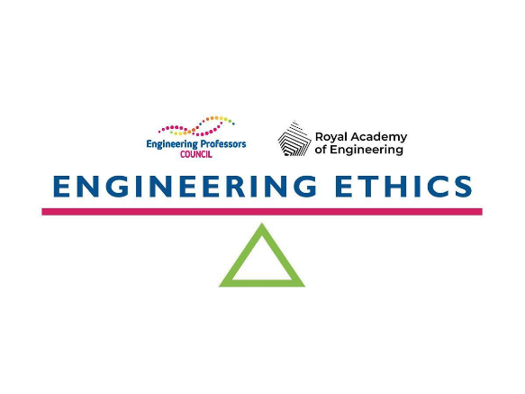
The Engineering Professors’ Council is the representative body for engineering academics in UK higher education.
The Engineering Ethics Toolkit was created by the Engineering Professors’ Council with support from the Royal Academy of Engineering. It addresses the issue that relatively few university engineering courses explicitly embed ethics teaching throughout the curriculum.
The Engineering Ethics Toolkit is a suite of interactive resources, guidance and teaching materials that aim to engage educators, and enable them to introduce ethics into the education and training of every engineer.
It features ready-to-use classroom resources that are rooted in educational best practice and align with the Accreditation of Higher Education Programmes (AHEP) criteria, which are the conditions for courses to receive professional accreditation.
These resources highlight current and emerging real-world issues and can be used and adapted by anyone. The latest additions to the Engineering Ethics Toolkit include the interactive Ethics Explorer, which helps educators understand, plan for and implement ethics learning, and 30 new academic guidance articles, case studies and comprehensive classroom activities created and developed by academic and industry professionals.
The Ethics Ambassadors community champions the teaching of ethics within engineering courses and modules and supports educators integrating ethics teaching.
Engineering Ethics Toolkit: epc.ac.uk/resources/toolkit/ethics-toolkit
Ethics Explorer: engineeringethics.epc.ac.uk
Ethics Ambassadors: epc.ac.uk/network/communities/ethics-ambassadors/

